Slide 1



Home
About
Solution
Approach Details
TEAM - 5

Slide 2

Home
About
Solution
Approach Details
TEAM AND PROBLEM STATEMENT
Team Name : Team 5
Problem Statement : The project addresses the need for a 360-degree feedback software for monitoring Government of India-related news stories in regional media using Artificial Intelligence and Machine Learning.
Team Lead: ATLA HARSHA VARDHAN
Team Member 1 : BADUGU AJAY
Team Member 2 : ARETI HIMA PADMAVATHI
Team Member 3 : CHIPPALA HARI KUMAR

Slide 3
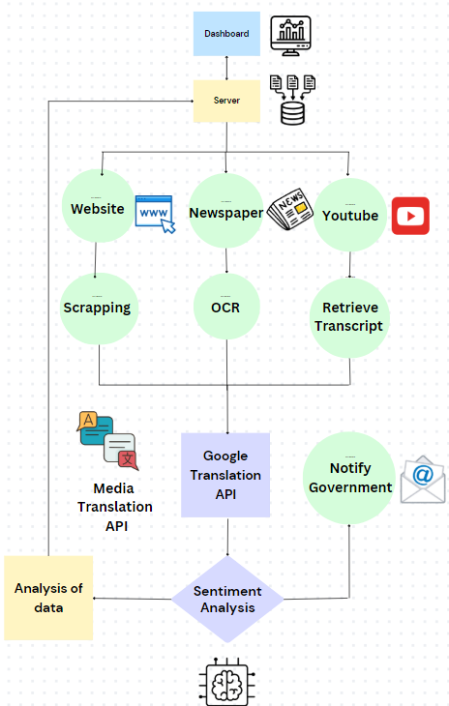
SOLUTION :
Home
About
Solution
Approach Details
Home
Service
Contact
Automated Data Collection:
Develops a system to scrape news articles and videos from multiple sources, including websites, e-newspapers, and YouTube channels.
Extracted data is processed to identify key details like headline, content, publication date, and source URL.
01
Categorization and Sentiment Analysis:
Classifies articles based on the ministry’s jurisdiction using an accurate machine learning model.
Performs sentiment analysis (Positive, Neutral, or Negative) for actionable insights.
02
Real-Time Alerts and Notifications:
Sends alerts for negative news articles to respective government departments via email for immediate response.
Provides timely updates on critical news events.
03
04
User-Friendly Interface:
Displays news on a simple and intuitive dashboard that supports multiple languages (English, Hindi, and regional languages).
Offers features like manual refresh, automatic hourly updates, and easy filtering by sentiment and ministry.

Slide 4






Approach details :
Home
About
Solution
Approach Details
Crawled 12000+ news articles and videos using Python Beautiful Soup and Selenium Library.
Applied clustering on these articles to label them into different categories to prepare labeled dataset.
Trained this dataset of articles using BERT model to generate department predictions.
Used Roberta model to implement sentiment analysis on news articles.
Sending mail of Negative News to respective departments using NodeMailer and Gmail - SMTP
Integrated this model and crawling functionality with a Django backend and wrote APIs for generating predictions and sentiments.
Merged this backend with a simple and attractive UI where user can give triggers to load latest news articles with their analysis.
Implemented video news analysis using Selenium library by first extracting audio and converting it into text. Then applied classification and sentiment analysis on the extracted text.
Developed the same functionalities for news in Telugu, Hindi and others languages as well using Google Translate API.
Technology Stack :
AI: PyTorch, TensorFlow, and BERT libraries for creating ML models.
Crawling: Beautiful Soup, Selenium
Server: Django backend.
Frontend: HTML , CSS,
JavaScript .

Slide 5
Home
About
Solution
Approach Details
THANK YOU

